Slide 1

Xamarin.Forms Advanced Topics
ALEJANDRO RUIZ
Microsoft MVP
@alejandroruizva

Slide 2
Agenda
DataTemplate Selector
Themes / Styles
Behaviors
Triggers
Renderers - Effects
Dependency Service
Platform-Specifics
Visual State Manager

Slide 3
DataTemplate Selector
A DataTemplateSelector can be used to choose a DataTemplate at runtime based on the value of a data-bound property. This enables multiple DataTemplates to be applied to the same type of object in order to customize the appearance of select objects.

Slide 4
Themes / Styles
Xamarin.Forms applications often contain multiple controls that have an identical appearance. Setting the appearance of each individual control can be repetitive and error prone. Instead, styles can be created that customize control appearance by grouping and settings properties available on the control type.

Slide 5
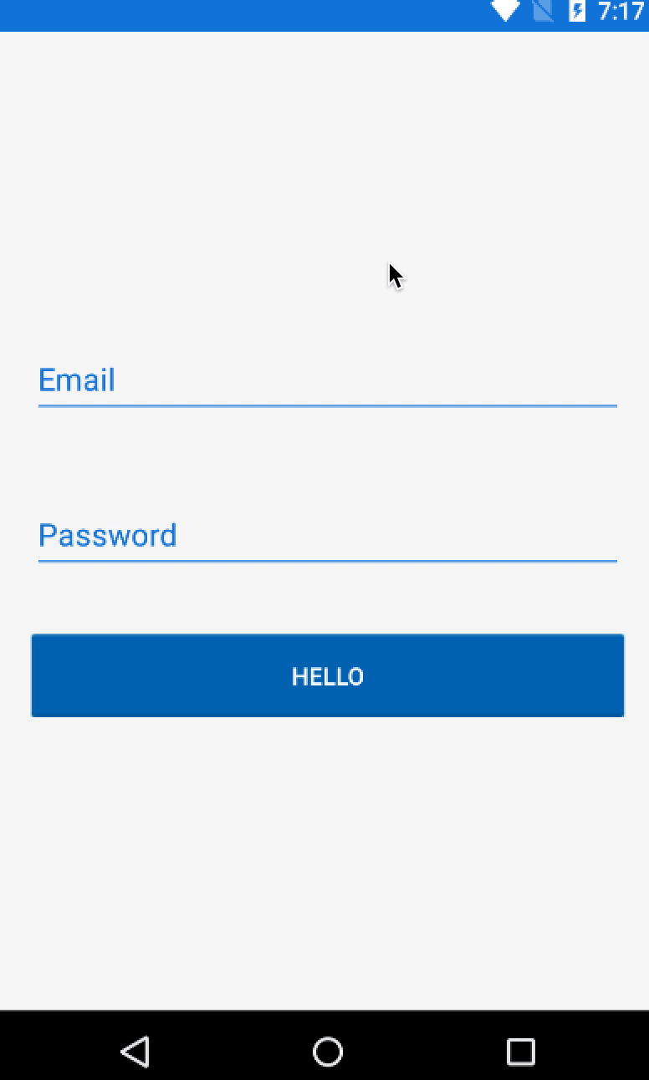
Behaviors
Behaviors lets you add functionality to user interface controls without having to subclass them. Behaviors are written in code and added to controls in XAML or code.

Slide 6
Triggers
Triggers allow you to express actions declaratively in XAML that change the appearance of controls based on events or property changes.
You can assign a trigger directly to a control, or add it to a page-level or app-level resource dictionary to be applied to multiple controls.

Slide 7
Renderers - Effects
Renderers: Xamarin.Forms user interfaces are rendered using the native controls of the target platform, allowing Xamarin.Forms applications to retain the appropriate look and feel for each platform. Custom Renderers let developers override this process to customize the appearance and behavior of Xamarin.Forms controls on each platform.
Effects: Xamarin.Forms user interfaces are rendered using the native controls of the target platform, allowing Xamarin.Forms applications to retain the appropriate look and feel for each platform. Effects allow the native controls on each platform to be customized without having to resort to a custom renderer implementation.

Slide 9
Dependency Service
Xamarin.Forms allows developers to define behavior in platform-specific projects. DependencyService then finds the right platform implementation, allowing shared code to access the native functionality.

Slide 10
Platform-Specifics
Platform-specifics allow you to consume functionality that's only available on a specific platform, without implementing custom renderers or effects.

Slide 11
Visual State Manager
The VSM provides a structured way to make visual changes to the user interface from code. In most cases, the user interface of the application is defined in XAML, and this XAML includes markup describing how the Visual State Manager affects the visuals of the user interface.

Slide 12
References
https://docs.microsoft.com/en-us/xamarin/xamarin-forms/app-fundamentals/templates/data-templates/selector
https://docs.microsoft.com/en-us/xamarin/xamarin-forms/user-interface/styles/xaml/
https://docs.microsoft.com/en-us/xamarin/xamarin-forms/app-fundamentals/behaviors/
https://docs.microsoft.com/en-us/xamarin/xamarin-forms/app-fundamentals/triggers
https://docs.microsoft.com/en-us/xamarin/xamarin-forms/app-fundamentals/custom-renderer/

Slide 13
References
https://docs.microsoft.com/en-us/xamarin/xamarin-forms/app-fundamentals/effects/
https://docs.microsoft.com/en-us/xamarin/xamarin-forms/app-fundamentals/dependency-service/introduction
https://docs.microsoft.com/en-us/xamarin/xamarin-forms/platform/platform-specifics/
https://docs.microsoft.com/en-us/xamarin/xamarin-forms/user-interface/visual-state-manager

Slide 14
Questions?
Alejandro Ruiz
Microsoft MVP: Developer Technologies
Xamarin.Forms Advanced Topics
DEMO: https://github.com/AlejandroRuiz/AdvancedTopicsCommunityAnniversary
alejandro@alejandroruizvarela.com
https://alejandroruizvarela.blogspot.mx
@alejandroruizva

